Slide 1

Introduction
Soheil Abbasloo
Department of Computer Science
University of Toronto
Fall 2022

Slide 2
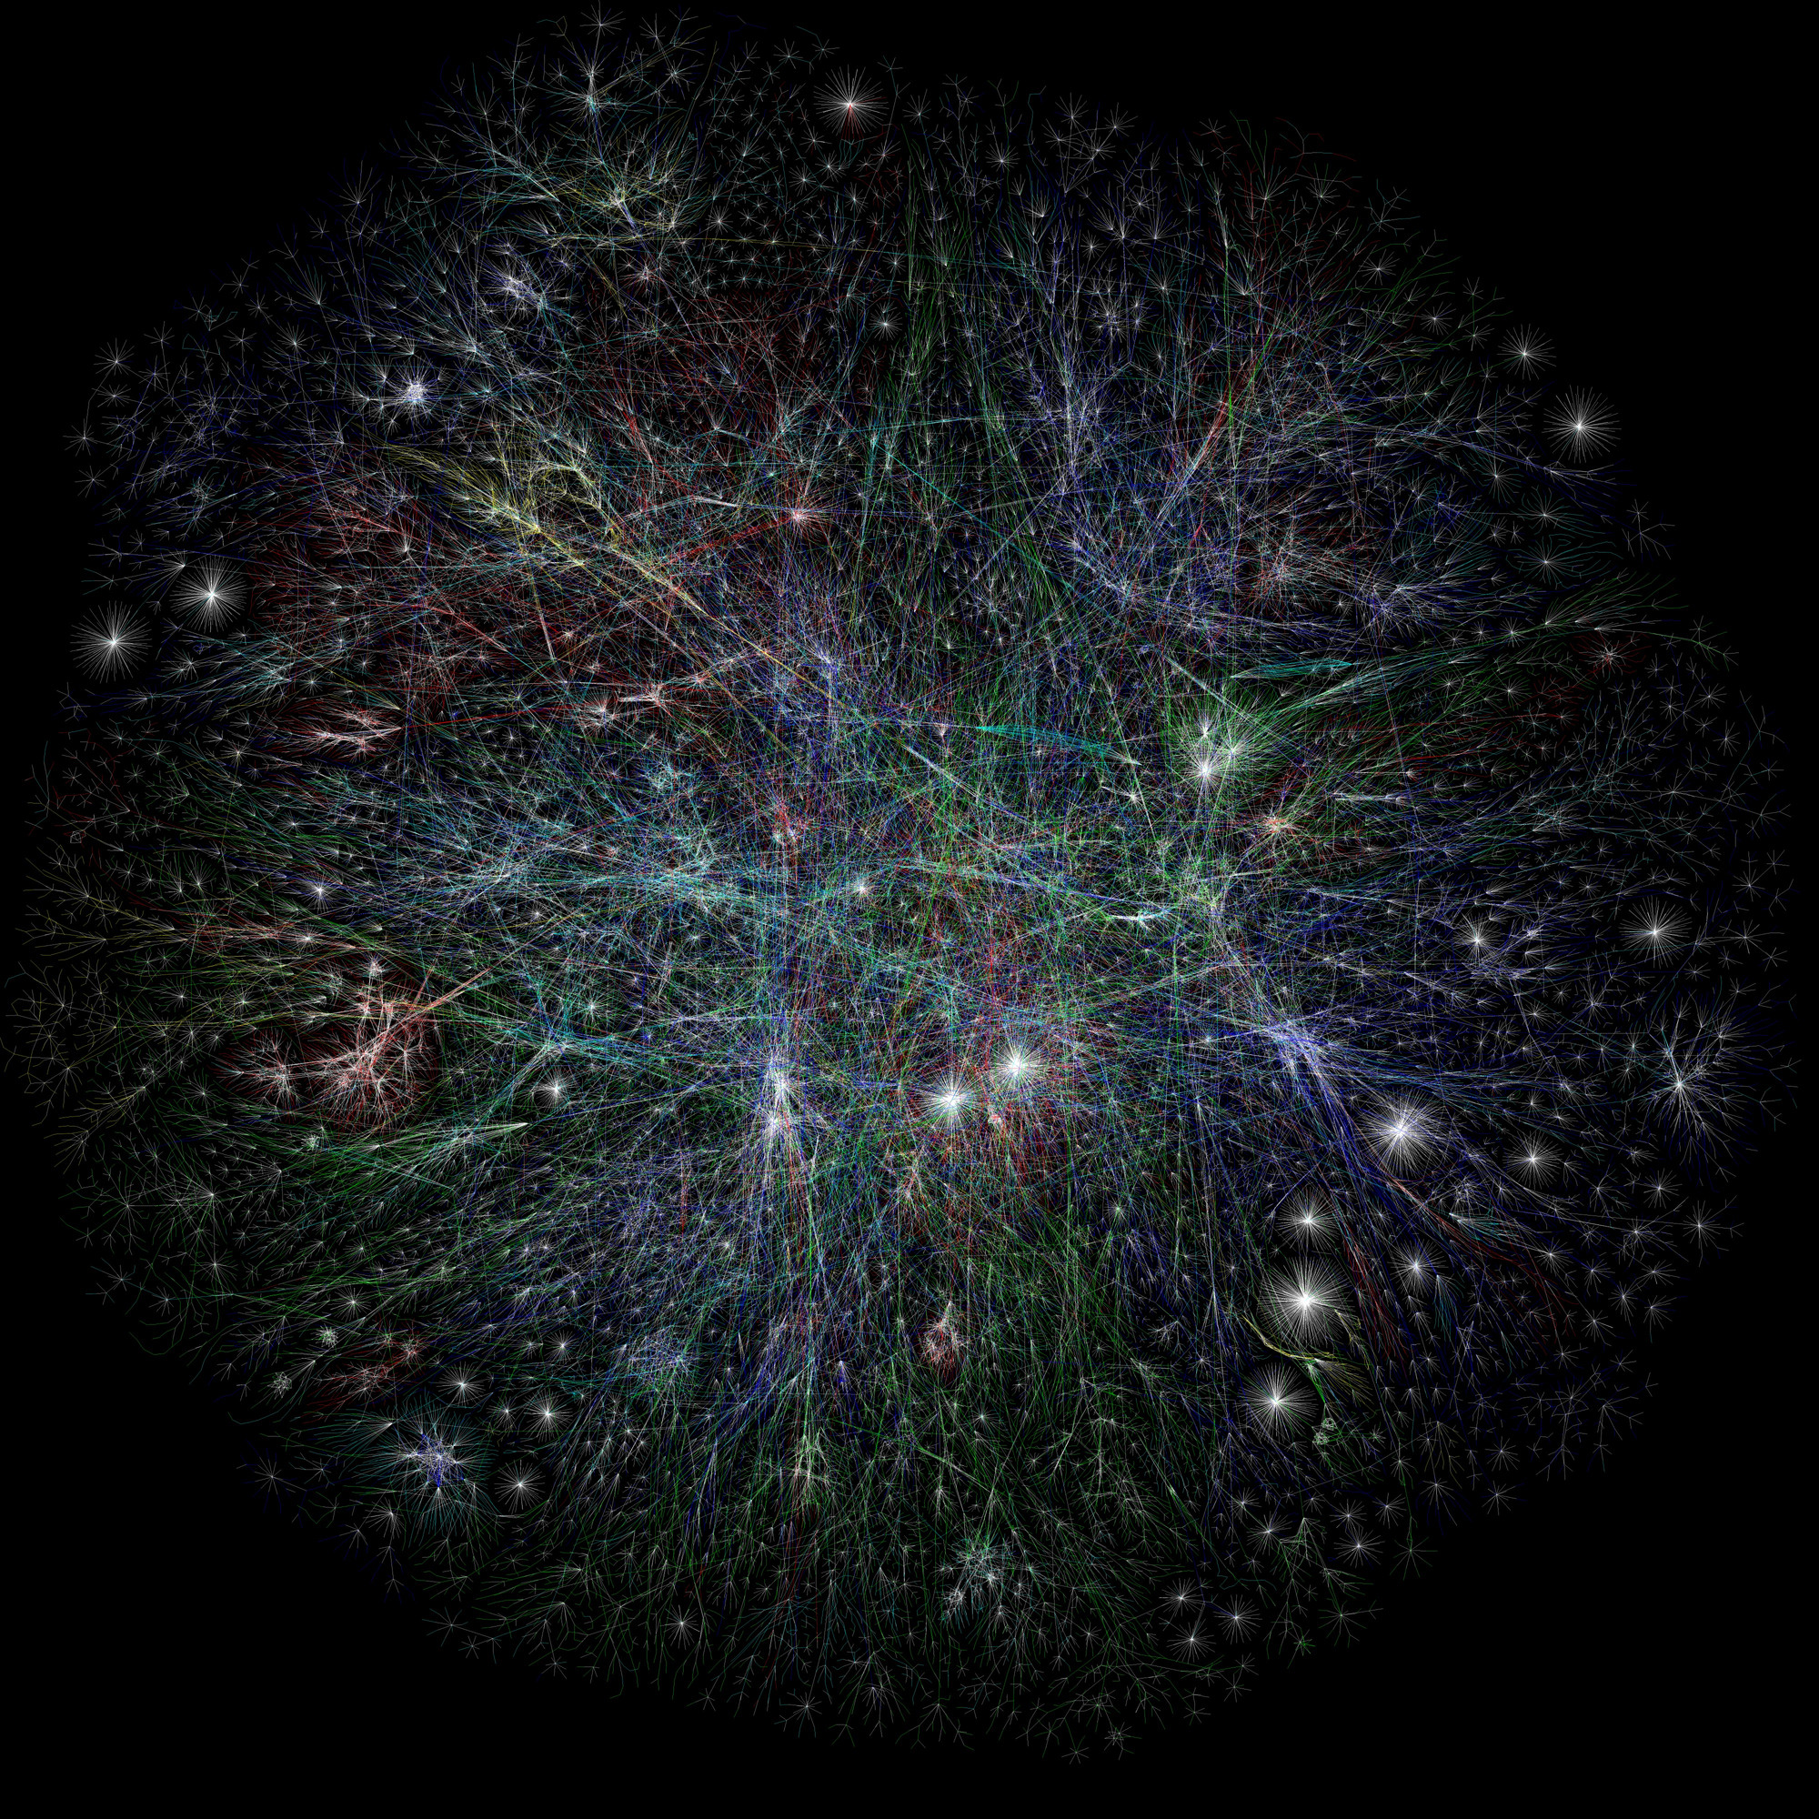
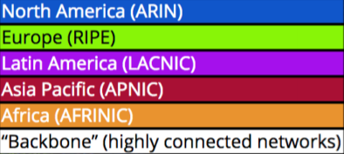
Barrett Lyon, The Opte Project

Slide 3
The Internet

Slide 4
The Internet An exciting place

Slide 5

$\sim$26 Billion
estimated* # of Internet connected devices in 2022

Slide 6

$\sim$30 Billion
estimated* # of Internet connected devices in 2023

Slide 7
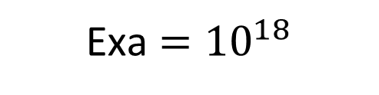

$\sim$13 Exabyte
estimated* daily global IP traffic in 2022
Exa $={10}^{18}$

Slide 8
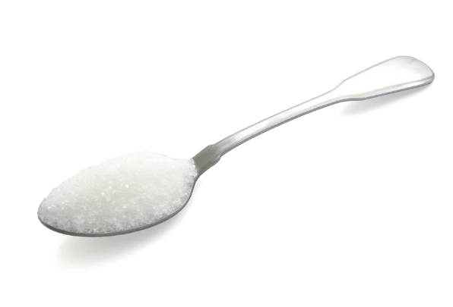
If = 1 Byte

Slide 9
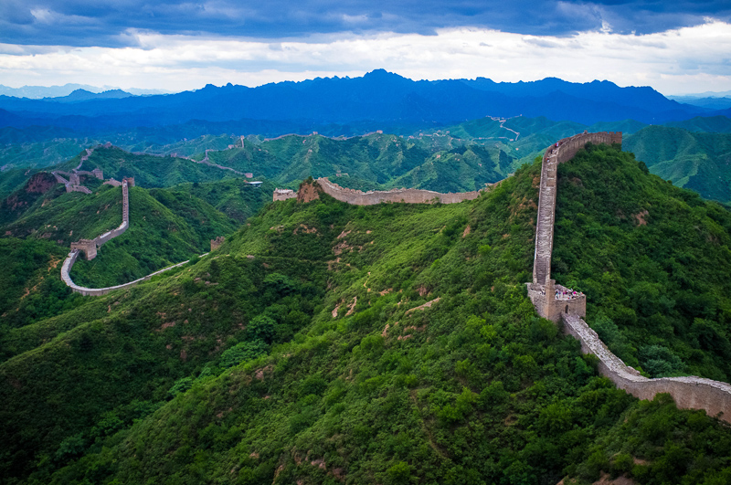
5000 $×$ Volume(Great Wall of China) $≈$ 1 Exabyte

Slide 10
The Internet A fragile place

Slide 11
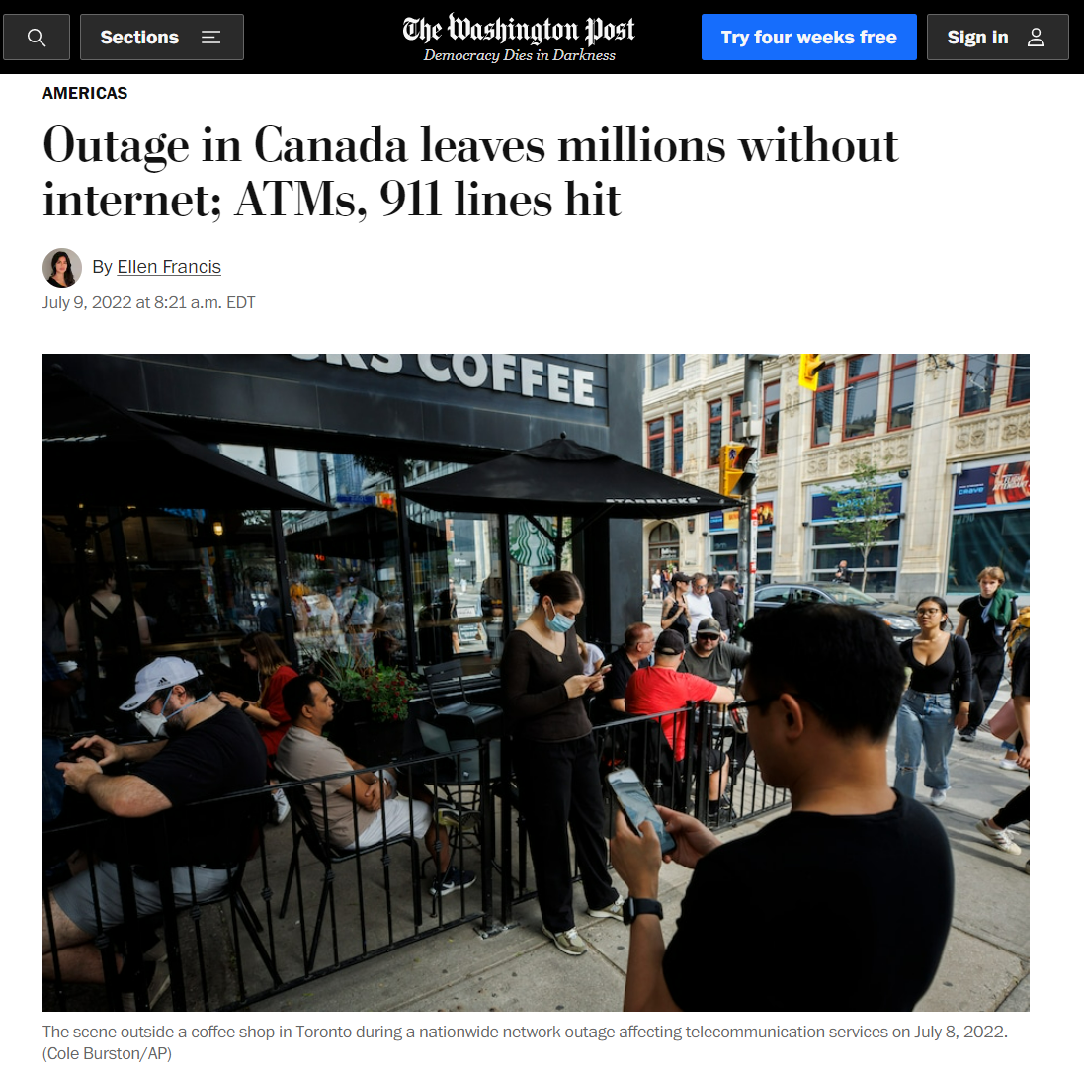
Despite being absolutely critical,
the Internet infrastructure is
inherently fragile

Slide 12
“An update in our [Rogers] core IP [internet protocol] network …
caused our IP routing network to malfunction,"

Slide 13
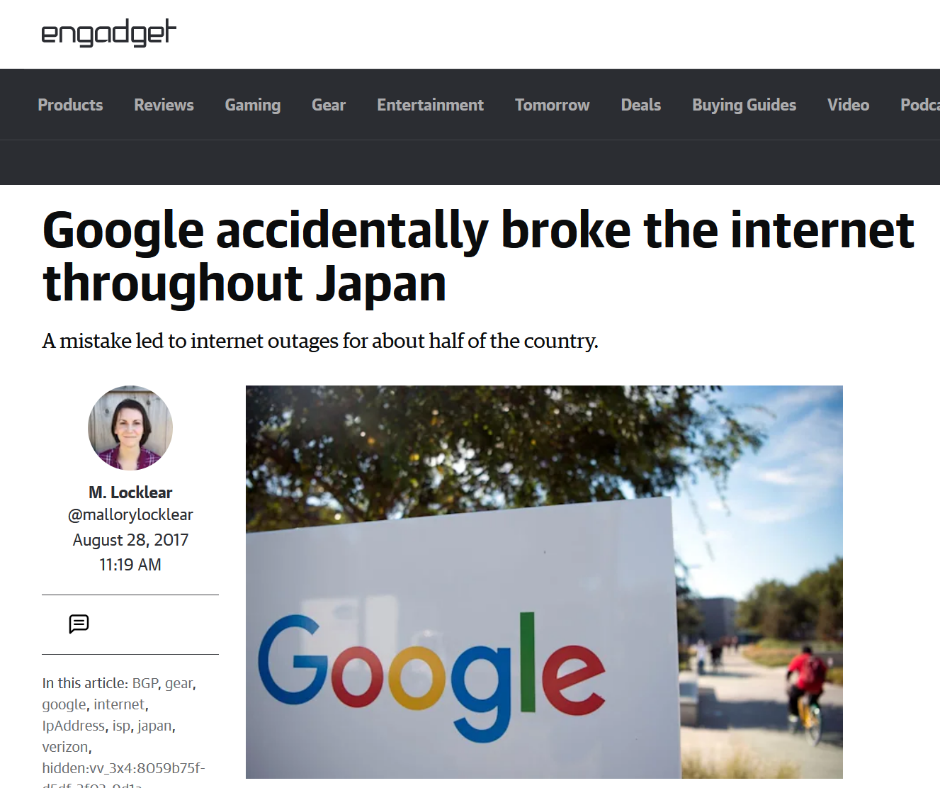

Slide 14
“Someone in Google fat-thumbed a
Border Gateway Protocol (BGP) advertisement
and sent Japanese Internet traffic into a black hole.”

Slide 15
Course Goals

Slide 16
Course Goals
How the Internet works
With the focus on
Key intuitions and design ideas

Slide 17
Course Goals
How the Internet works
With the focus on
Key intuitions and design ideas
From Basics: Naming, Layering, Socket Programming, Packet Switching, Reliability, Sharing, etc.
To Advance Networking: Routers and Switches, Security, Congestion Control, Software Defined Networking, etc.
Notes:
Make you ready
to reason about (and architect) a distributed system/network ;)

Slide 18

Course Web Page:
http://www.cs.toronto.edu/~abbasloo/teaching/csc458/
Slides, assignments, readings, course info, …
Class on Piazza:
https://piazza.com/utoronto.ca/fall2022/csc458
Access Code: csc458#fall22!
Q&A, Questions related to the course, a response time guarantee < 48 hours!

Slide 19
Each TA is responsible for certain assignment!
Please check class web page for the list of TAs
And which assignments they are responsible for.
Only contact TAs regarding their assigned assignments!
Textbook
“Computer Networks: A Systems Approach”, (5th Edition), Peterson, Davie, 2011
Recommended books
“UNIX Network Programming, Volume I: The Sockets Networking API”, W. Richard Stevens, Bill Fenner, and Andrew M. Rudoff, 3rd edition, 2003
“TCP/IP Illustrated, Volume 1: The Protocols”, W. Richard Stevens, 1993

Slide 20
Your Final Grade
Programming Assignments
Problem Sets
Midterm Exam
Final Exam
30%
20%
20%
30%

Slide 21
Academic Integrity
All submissions must present original, independent work.
We take academic offenses very seriously.
Please read
Course information sheet
“Guideline for avoiding plagiarism” http://www.cs.toronto.edu/~fpitt/documents/plagiarism.html
“Advice about academic offenses” http://www.cs.toronto.edu/~clarke/acoffences/

Slide 22
Accessibility Needs
The University of Toronto is committed to accessibility.
If you require accommodations or have any accessibility concerns, please visit http://studentlife.utoronto.ca/accessibility as soon as possible.

Slide 23
Special Thanks To:
Scott Shenker & Sylvia Ratnasamy from UC, Berkeley
Jennifer Rexford from Princeton University
Nick McKeown from Stanford University

Slide 24
How the Internet Works
(a very very short version!)

Slide 25


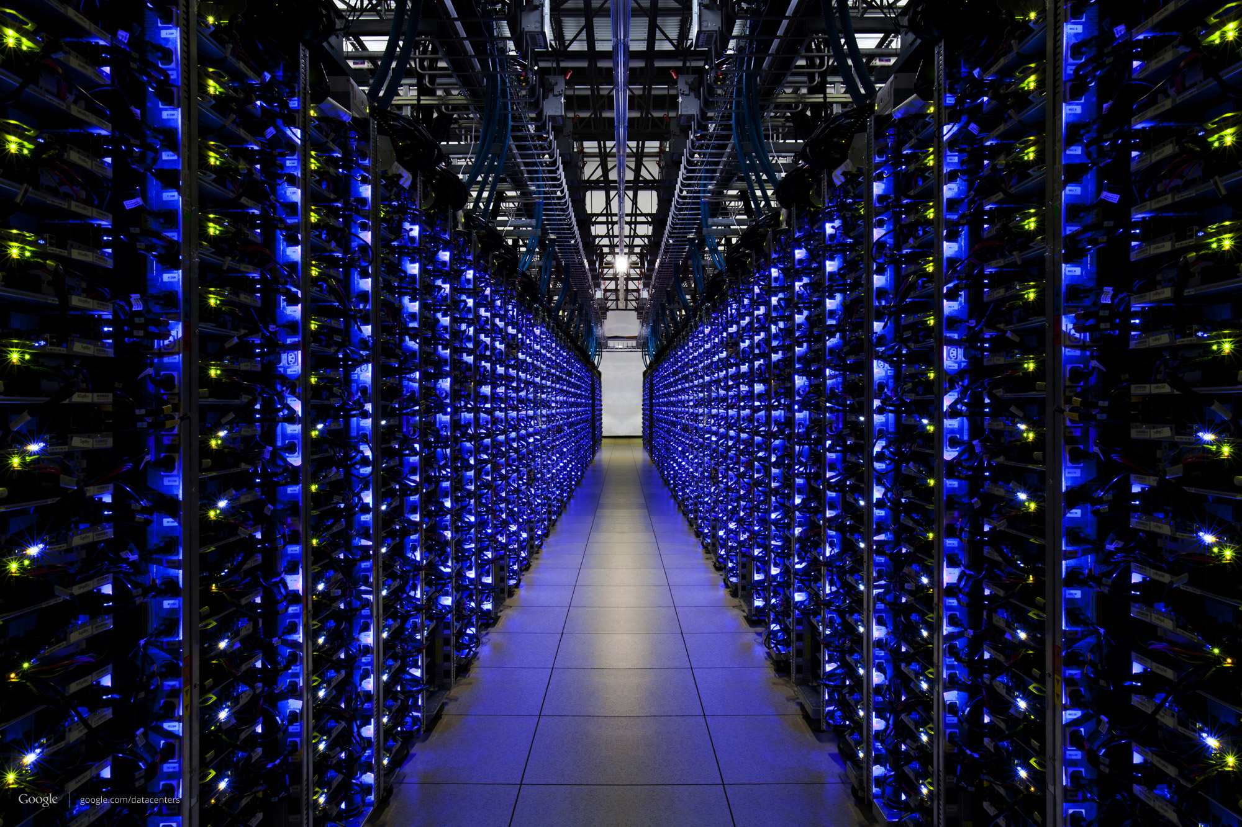
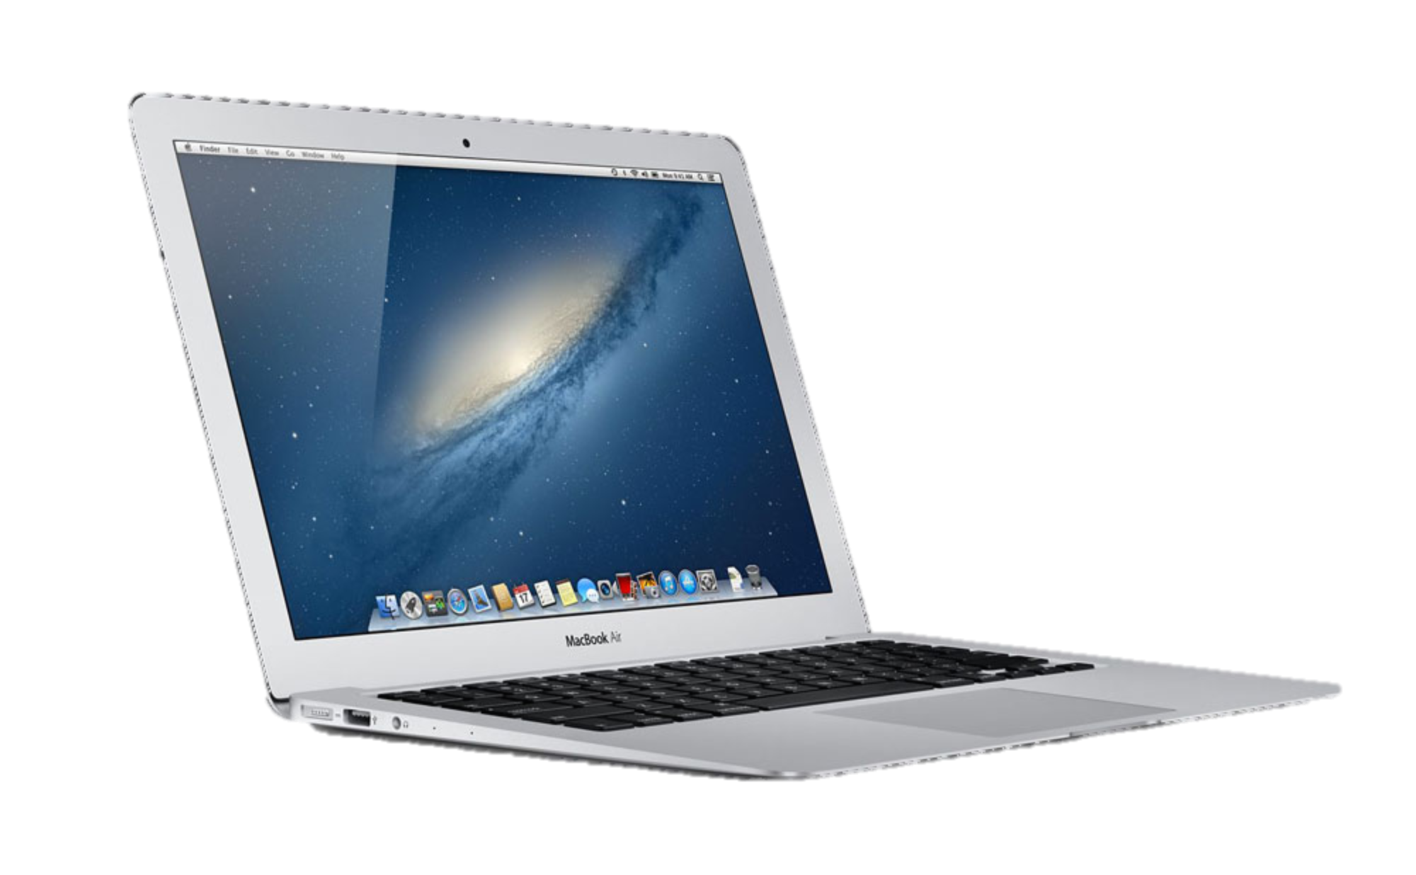
www.cs.toronto.edu

Slide 26

Someone else’s
Program
My
Program

Slide 27

Data
Data

Slide 28
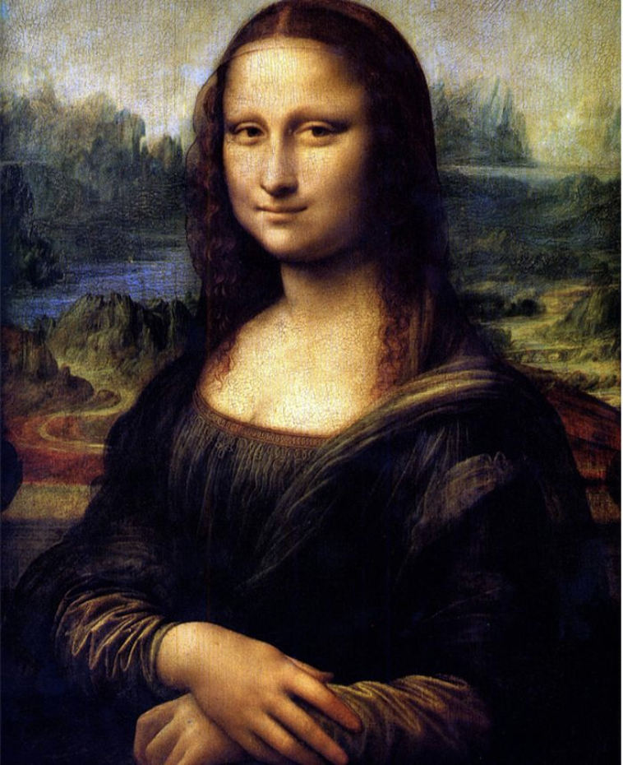
Notes:
Let’s see how this image is sent across the Internet from one smartphone to another….

Slide 29
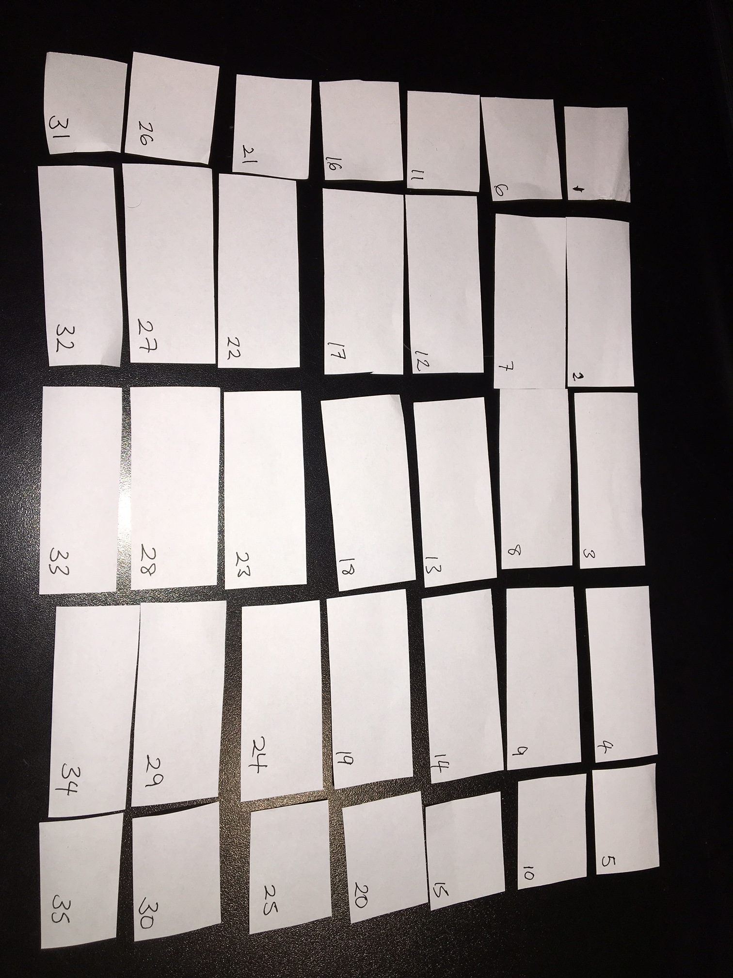

Slide 30




A more accurate model
From
Address
Soheil Abbasloo
40 St George St,
Toronto, ON M5S 2E4
CA
To
Address
Me
You

Slide 31
Multiple packets in pipeline at same time
Soheil Abbasloo
40 St George St,
Toronto, ON M5S 2E4
CA
Soheil Abbasloo
40 St George St,
Toronto, ON M5S 2E4
CA
Soheil Abbasloo
40 St George St,
Toronto, ON M5S 2E4
CA
Soheil Abbasloo
40 St George St,
Toronto, ON M5S 2E4
CA
Soheil Abbasloo
40 St George St,
Toronto, ON M5S 2E4
CA
Me
You

Slide 32
Packets may be damaged
?!%%*
Data
Data

Slide 33
Packets may arrive out of order
1
2

Slide 34
Packets may be duplicated
Duplicate
Data
Data

Slide 35
They may not arrive at all!
Data
Data
Full

Slide 36
Summary so far
Applications send and receive data in packets….
…over an Internet that is unreliable.

Slide 37
How packets find their way across the Internet

Slide 38
Internet addresses
Data
Internet “IP”
Address
Data

Slide 39
Internet Addresses (“IP address”)
Data
Internet “IP”
Address
All Internet packets carry a destination IP address.
We usually write the IP address like this:
128.100.20.20

Slide 40
Routers forward packets one at a time.
Routers look at IP addresses, then send packets to a router closer to the destination.
Data
Data

Slide 41
IP Addresses
The IP address tells a router where to send the packet next.
IP addresses have structure
A computer at that network
A network in the CS department at UofT
UofT
128.100.20.20
An address at Sharif University of Technology
A computer There
A network in Middle East
213.233.161.70

Slide 42
Can we see the path our packets take?
Yes!
On your computer, try: “ping google.com”
and “traceroute google.com”
(Windows: “tracert google.com”)
Notes:
traceroute –q1 yuba.stanford.edu

Slide 43
ping www.doshisha.ac.jp
From Toronto, it takes about 190ms to reach Japan and back again (“round-trip-time”)

Slide 44
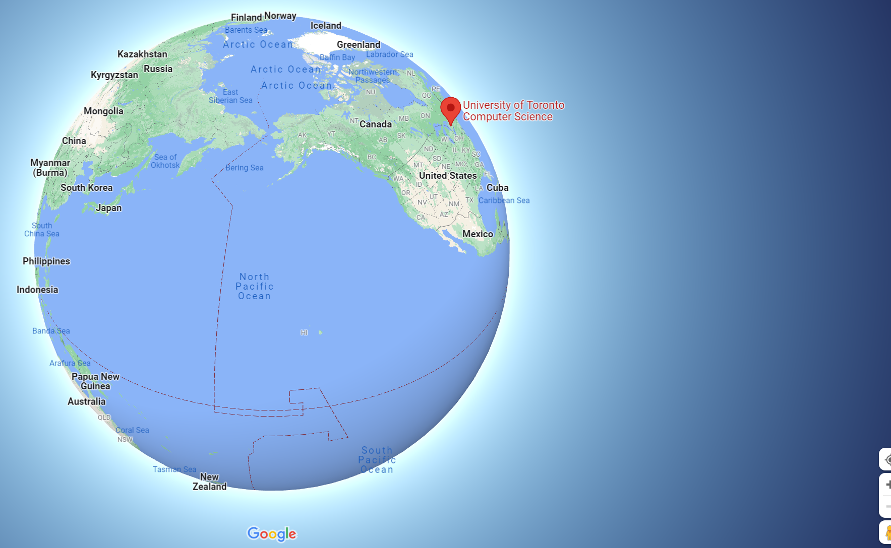
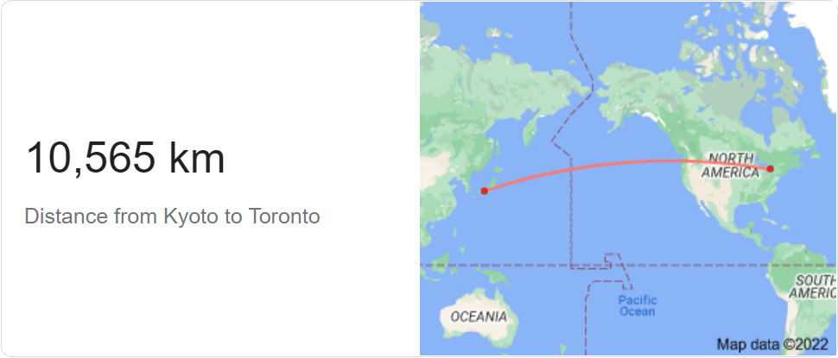
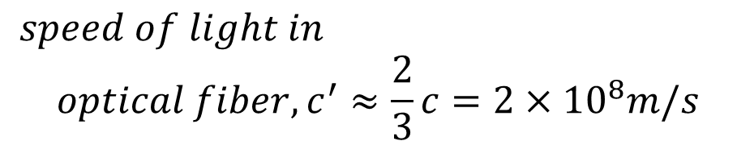
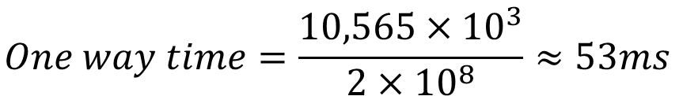
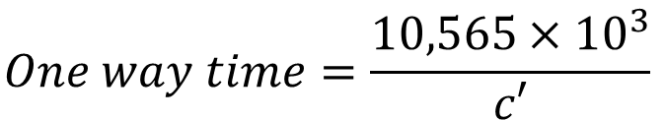
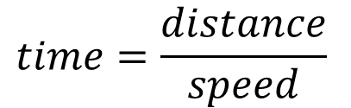
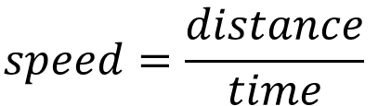
10,565km
RTT = 106ms
$$speed=\frac{distance}{time}$$
$$time=\frac{distance}{speed}$$
$$One way time=\frac{10,565×{10}^{3}}{c′}$$
Kyoto
$$speed of light in$$
$$optical fiber, c^{′}≈\frac{2}{3}c=2×{10}^{8}m/s$$
$$One way time=\frac{10,565×{10}^{3}}{2×{10}^{8}}≈53ms$$
$$Round trip time=2×53ms=106ms$$
Q: So why did my “ping” take 190ms?

Slide 45
traceroute

Slide 46
From Toronto to Doshisha University (Kyoto)
Soheil@ Home on Bell Network > traceroute –f 4 -q1 istc.doshisha.ac.jp
traceroute to istc.doshisha.ac.jp (202.23.190.159), 30 hops max, 60 byte packets
4 *
5 tcore4-toronto12_37.net.bell.ca (64.230.59.200) 24.838 ms
6 cr01-mtrlpq01h33_bundle-ether9.net.bell.ca (142.124.127.231) 19.103 ms
7 tcore4-montreal02_bundle-ether57.net.bell.ca (142.124.127.250) 26.140 ms
8 tcore4-newyorkaa_hundredgige0-3-0-0.net.bell.ca (64.230.79.144) 24.725 ms
9 bx7-newyork83_hundredgige0-7-0-0.net.bell.ca (64.230.79.91) 23.612 ms
10 NYIIX.IIJ.Net (198.32.160.42) 27.037 ms
11 nyc002bb00.IIJ.Net (58.138.81.49) 29.022 ms
12 sea001bb00.IIJ.Net (58.138.81.58) 73.050 ms
13 tky009bb00.IIJ.Net (58.138.88.225) 156.554 ms
14 tky009ix50.IIJ.Net (58.138.114.230) 167.123 ms
15 202.232.6.18 (202.232.6.18) 162.362 ms
16 150.99.18.34 (150.99.18.34) 192.893 ms
17 doshisha-LAN.gw.sinet.ad.jp (150.99.196.66) 189.294 ms
18 *

Slide 47
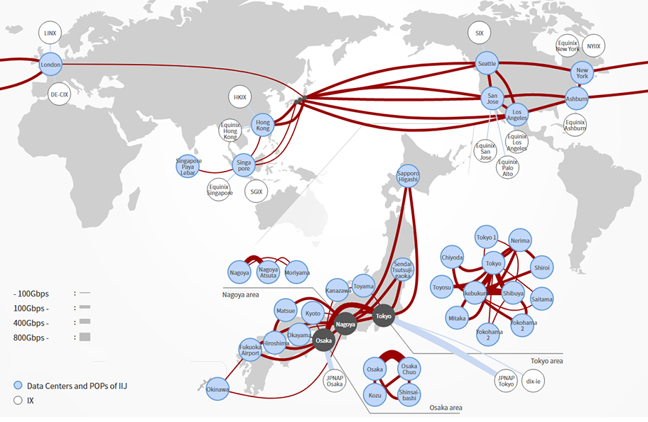
Internet Initiative Japan’s (IIJ’s) Backbone Network
Toronto -> Montreal -> NYC -> London -> Tokyo -> Kyoto !
https://bit.ly/3Jd9kM1
Notes:
Internet Service Providers -> Tier 1, 2, and 3 …

Slide 48
Toronto-Montreal : 550km
Montreal-NYC: 600km
NYC-London: 5,600km
London-Tokyo: 9,500km
Tokyo-Kyoto: 500km
Kyoto
RTT ~= 170ms

Slide 49
Try traceroute to….
www.ntua.gr, www.netflix.com, wikipedia.org, …

Slide 50
Competition (optional)
Task: Find the longest loop-free traceroute in the Internet
Rules
The source and destination can be any addresses you can reach.
At most one hop may return a “*” (i.e. not respond)
Packets must flow over physical links and through real routers. i.e. not a virtual, simulated or emulated network.
Prize: Big bragging rights!

Slide 51
Summary so far
Applications send and receive data in packets….
…over an Internet that is unreliable.
Packets are forwarded hop-by-hop based on the final destination address.

Slide 52
The Internet cannot be trusted!!
The Internet doesn’t promise to deliver packets in order.
It doesn’t promise to deliver packets quickly, or on time.
It doesn’t even promise to deliver them at all!
It just makes a “best-effort” attempt.
Data

Slide 53
Sending data reliably over an Internet that is unreliable

Slide 54
How Network Applications Communicate
Someone else’s
Program
My
Program
The most common method:
Communication is in both directions – “bidirectional”.
Communication is reliable (if there is a working path between the two computers).
It’s like an unformatted pipe:
You push data in at one end, and it pops out correctly at the other end.
The applications decide how the data is formatted inside the pipe.

Slide 55

Byte Stream Model
Setup connection
Internet
A
B

Slide 56
Byte Stream Model
Stream of bytes
Stream of bytes
Internet
A
B

Slide 57
Byte Stream Model
Close connection
Internet
A
B

Slide 58
World Wide Web (HTTP)
Client
Server
Setup connection
Internet
www.utoronto.ca

Slide 59
World Wide Web (HTTP)
Client
Server
Stream of bytes
GET/HTTP/1.1 index.html
Internet
Stream of bytes
HTTP/1.1 200 OK <…contents of index.html…>
www.utoronto.ca

Slide 60
World Wide Web (HTTP)
Client
Server
Close connection
Internet
www.utoronto.ca

Slide 61
Your Application program
e.g. Chrome, Skype
The server
e.g. Google, Facebook
TCP makes sure all
the data is delivered
“TCP”
“TCP”
“IP”
“IP”
Data

Slide 62
TCP’s job
Makes sure all data is delivered correctly.
Delivers data to the application in the right order.
How?
Add sequence numbers to every packet (so the receiver can check if any are missing, and put them in right order)
When a packet arrives, send an acknowledgment of receipt or “ACK” back to the sender
If no acknowledgment is received, resend the data

Slide 64
Packets are “encapsulated” by different “layers” of processing

Slide 65
http client (e.g. Chrome)
Chrome
http request
Application
GET index.html
TCP
TCP
TCP
(http)
“Deliver to the http server”
(http)
IP
IP
TCP
IP address
(TCP)
IP
IP address
(TCP)
“…at this destination”
(http)
Ethernet
Ethernet
IP
Ethernet
Ethernet “MAC” address
(IP)
“…starting with this link”
TCP
Ethernet “MAC” address
(IP)
IP address
(TCP)
(http)

Slide 66
Here it goes….
Ethernet data
IP data
TCP data
IP Address
(TCP)
Ethernet “MAC” address
(IP)
(http)

Slide 67
http server (e.g. www.google.com)
http server
http request
Application
GET file
“Deliver to the http server”
TCP
TCP
(http)
“Deliver to TCP”
IP
Ethernet
IP
IP
Ethernet
TCP
TCP
Ethernet “MAC” address
(IP)
IP address (TCP)
IP address
(TCP)
(http)
(http)

Slide 68
Summary of what we learned
My
Program
Someone else’s
Program
Applications send and receive data in packets….
…over an Internet that is unreliable.
Packets are forwarded hop-by-hop using the IP destination address.
Our applications use TCP to make sure they are
delivered and put back in the correct order.

Slide 69
That was a very big picture of how the Internet works

Slide 70
That was a very big picture of How the Internet works Now, Let’s go back and start from the basics . . .

Slide 71
Back to the Basics: Part I

Slide 72
What is a network made of?

Slide 73
Three main components of a network
1- End-system

Slide 74
End-systems: send & receive data
MAC Laptop
Win PC
Smart Watch
Car navigator
Smart Refrigerator
Linux Server

Slide 75
2- Switch/Router

Slide 76
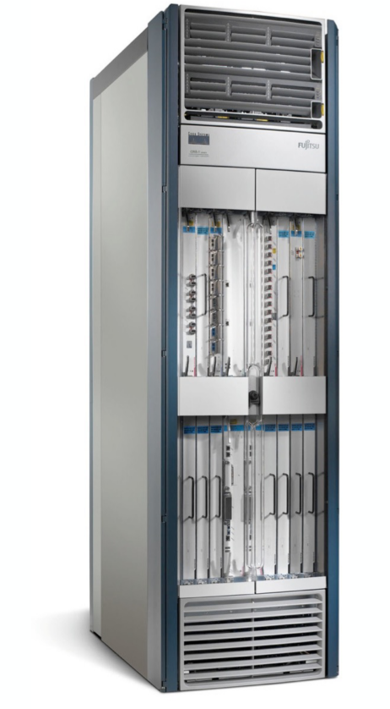
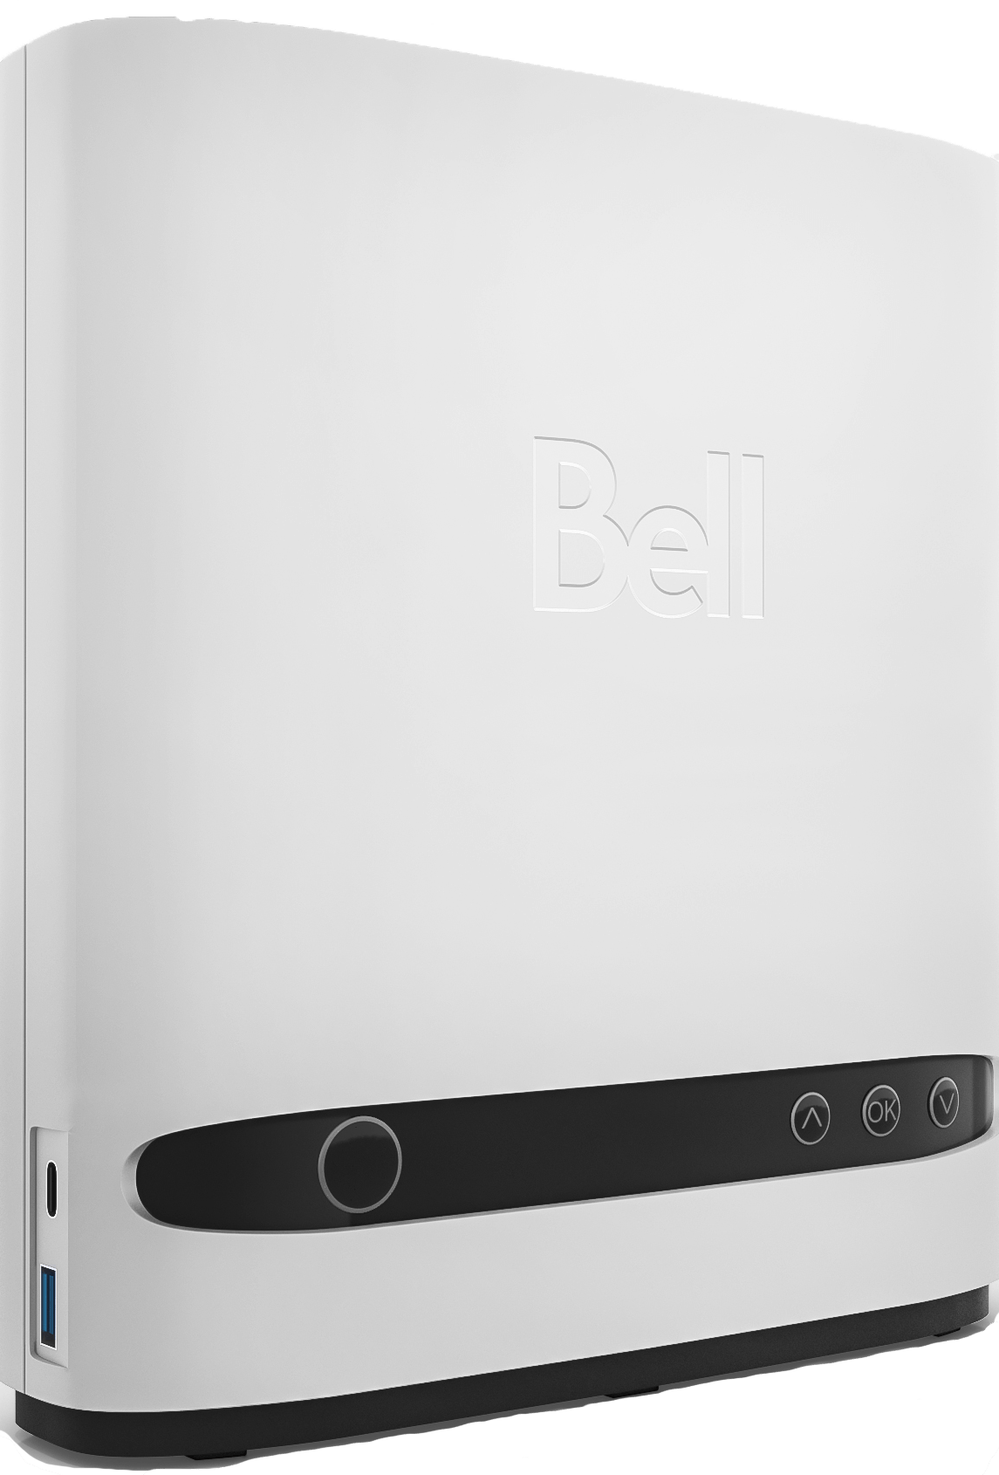
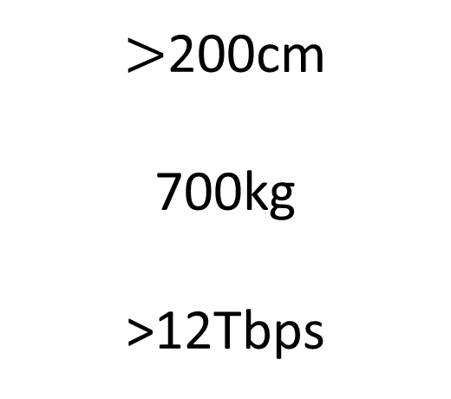
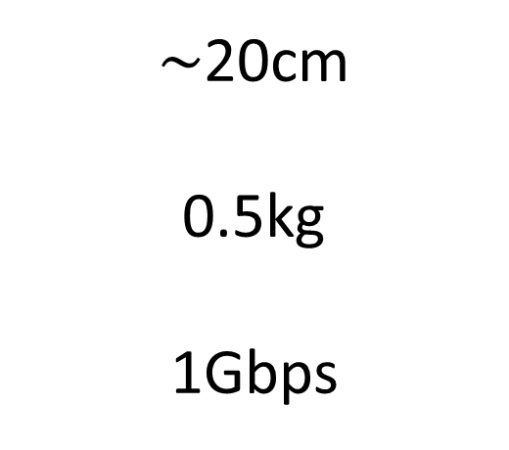
Switches & routers forward data to the destination
Home modem
Internet Core Router
$\sim$20cm
0.5kg
1Gbps
$>$200cm
700kg
>12Tbps
https://www.cisco.com/c/en/us/products/collateral/routers/carrier-routing-system/data_sheet_c78-726136.html

Slide 77
Links connect end-systems and switches
3- Link

Slide 78
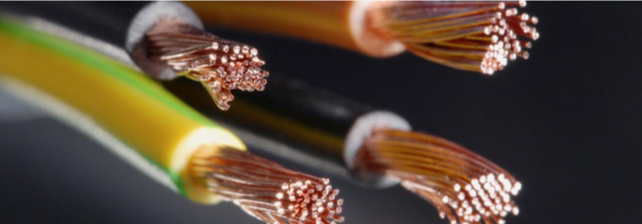
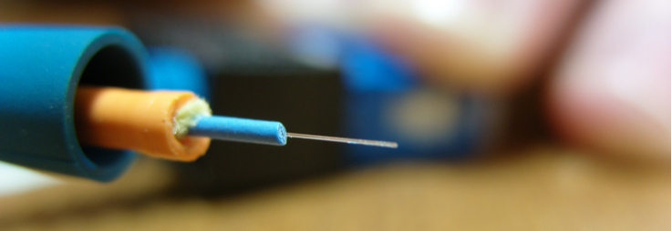
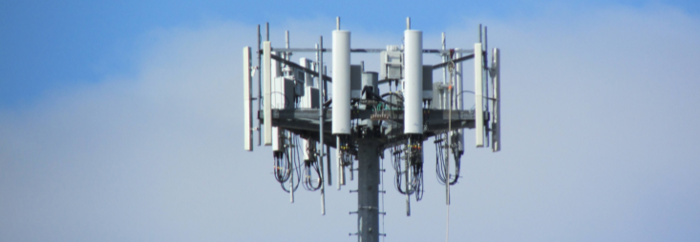
Different types of links for different types of usages
Copper
Optical Fiber
Wireless Links

Slide 79
How is a network shared?

Slide 80
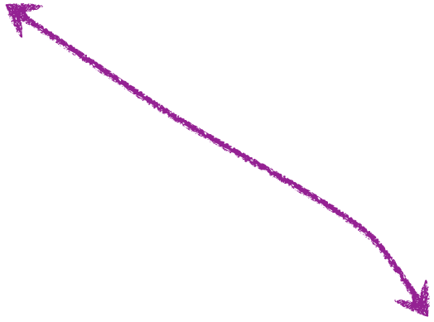
shared link and switch resources

Slide 81
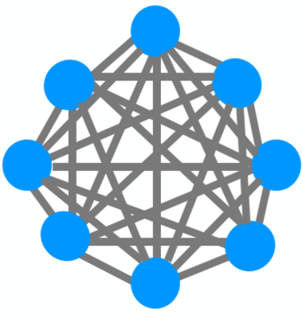
How do we scale a network to many end-systems?
Full mesh
Chain
Bus
number of links?
per-node capacity?

Slide 82
How do we scale a network to many end-systems?
Switched networks enable efficient scaling!

Slide 83
Two approaches to sharing
Reservations
On demand

Slide 84
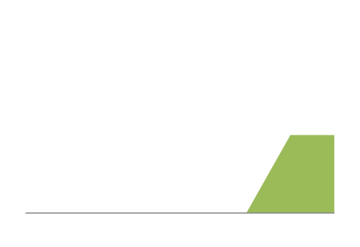
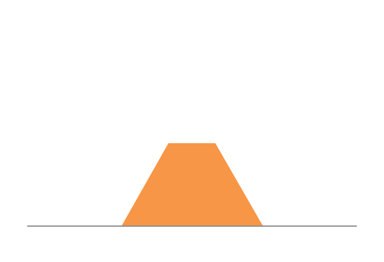
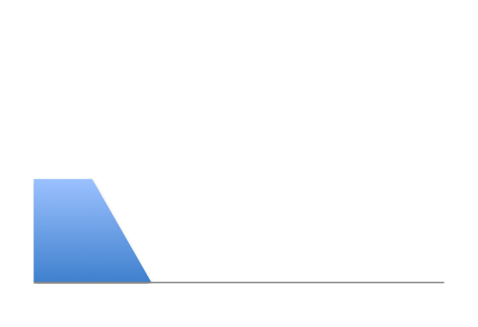
Intuition: Three sources of “bursty” traffic
12Mbps
Link capacity = 30Mbps
11Mbps
13Mbps
Time

Slide 85
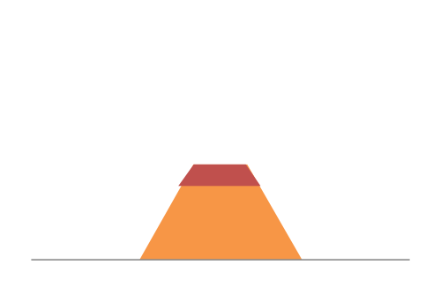
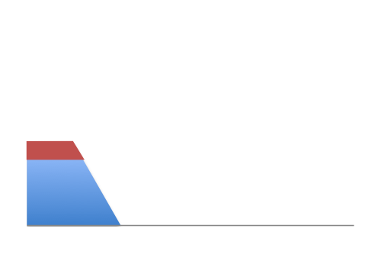
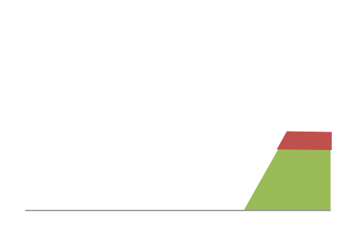
Intuition: reservations
Frequent overloading
12Mbps
Link capacity = 30Mbps
11Mbps
Each source gets 10Mbps
13Mbps
Time

Slide 86
Intuition: on demand
No overloading
Link capacity = 30Mbps
Time

Slide 87
Switching on-demand exploits statistical multiplexing better than reservations
Sharing using the statistics of demand
Good for bursty traffic (average << peak demand)

Slide 88

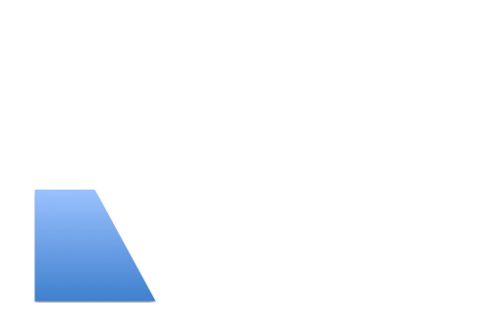
Intuition: on demand
Link capacity = 30Mbps
Time
What do we do under overload?

Slide 89
Statistical multiplexing is a recurrent theme in computer science
Phone network rather than dedicated lines
ancient history
Packet switching rather than circuits
today’s lecture
Cloud computing
shared vs. dedicated machines

Slide 90
Two approaches to sharing
Reservations
On demand
How are these implemented?

Slide 91
Two approaches to sharing
Reservations → circuit switching
On demand → packet switching
How are these implemented?

Slide 92
Two approaches to sharing
Packet switching
packets treated on demand
admission control: per packet
Circuit switching
resources reserved per active "connection"
admission control: per connection

Slide 93
Circuit Switching
10Mb/s?
dst
src
✔
10Mb/s?
✔
10Mb/s?
✔
src sends a reservation request to dst
(2) Switches “establish a circuit”
(3) src starts sending data
(4) src sends a “teardown circuit” message

Slide 94
Circuit Switching
switch
src
dst
Reservation establishes a “circuit” within a switch

Slide 95
Many kinds of “circuits”
Time division multiplexing
divide time in time slots
separate time slot per circuit
Frequency division multiplexing
divide frequency spectrum in frequency bands
separate frequency band per circuit
time
frequency
time

Slide 96
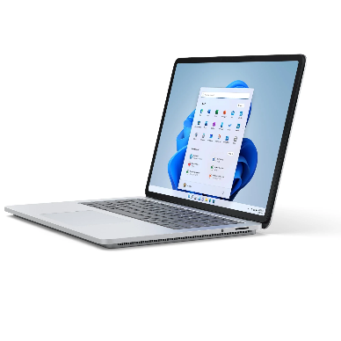
Timing in Circuit Switching
time

Slide 97
Timing in Circuit Switching
time

Slide 98
Timing in Circuit Switching
time

Slide 99
Timing in Circuit Switching
time

Slide 100
Timing in Circuit Switching
Circuit establishment
time

Slide 101
Timing in Circuit Switching
Data
Circuit establishment
Data transfer
time

Slide 102
Timing in Circuit Switching
Data
Circuit establishment
Data transfer
time
Circuit teardown
Notes:
Why the delays in the first pass of the establishment, but not in subsequent passes (or in teardown)?

Slide 103
Example of poor efficiency:
The circuit is mostly idle due to traffic bursts
Circuit establishment
Data transfer
time
Circuit teardown
Notes:
Why the delays in the first pass of the establishment, but not in subsequent passes (or in teardown)?

Slide 104
Example of poor efficiency:
The circuit is used for a short amount of time
Information
time
Notes:
Why the delays in the first pass of the establishment, but not in subsequent passes (or in teardown)?

Slide 105

Another problem of circuit switching
A
B
Circuit switching doesn’t “route around trouble”

Slide 106
Circuit Switching
Pros
predictable performance
simple/fast switching (once circuit established)
Cons
complexity of circuit setup/teardown
inefficient when traffic is bursty
circuit setup adds delay
switch fails → its circuit(s) fails

Slide 107
Packet switching
switch
dst
Each packet contains destination (dst)
Each packet treated independently

Slide 108
Packet switching
switch
dst
Each packet contains destination (dst)
Each packet treated independently
With buffers to absorb transient overloads

Slide 109
Packet Switching
Pros
efficient use of network resources
simpler to implement
robust: can “route around trouble”
Cons
unpredictable performance
requires buffer management and congestion control

Slide 110
To Reserve or not to Reserve?!

